Slide 1
Inventory Management System
1

Slide 2
Task Allocation
2
__________________________
Sanjay Kumar Sah(2000193): Create and Design Signup Page
Shahil Kumar(2000196): Front-End
Siddharth Kumar Sonu(2000206): Design Page
Sumit Kumar Giri(2000213): Back-End
Fronted: Works on all the offline pages with a tool (Tkinter) to do some impressive and magnificent look to our code.
Backend: Works on all the data behind the pages with Oracle Database system and connect to the frontend part.

Slide 3
Topics discussed in this presentation
_______________________________
Introduction about Project
Project Description
Project Methodology
Key Finding/Result
3

Slide 4

Introduction about Project
___________________________
4
What is Inventory Management System?
.
Inventory management refers to the process of ordering ,storing ,using and selling a company’s inventory. this includes the management of raw materials, components and finished product as well as warehousing and processing of such items.
Inventory management systems are your means of organizing all the elements that go into inventory management. It's the process by which you track goods from one end to the other along your supply chain. Ensuring throughout that you know what you have, where it is, and how to manage it.

Slide 5

Project Description
_______________________
5
Objective
.
.
Easy management of Inventory.
Handel details of sales, purchase, balance stock .
Make Stock Manageable.
Details with day to day requirement of any production organization.
Material Availability.
Better Level of Customer Service.
Keeping Wastage and Losses to a Minimum.
Cost-Effective Storage.
Optimizing Product Sales.

Slide 6
Procedure/Methodology
________________________
6
Procedure
Tkinter Programming.
Import the Tkinter module GUI application main window.
Add one or more of the widgets to the GUI application.
Enter the main event loop to take action against each event triggered by the user.

Slide 7

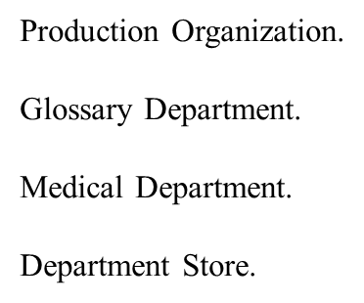
SCOPE
7

Slide 8
SNAPSHOTS
8

Slide 9
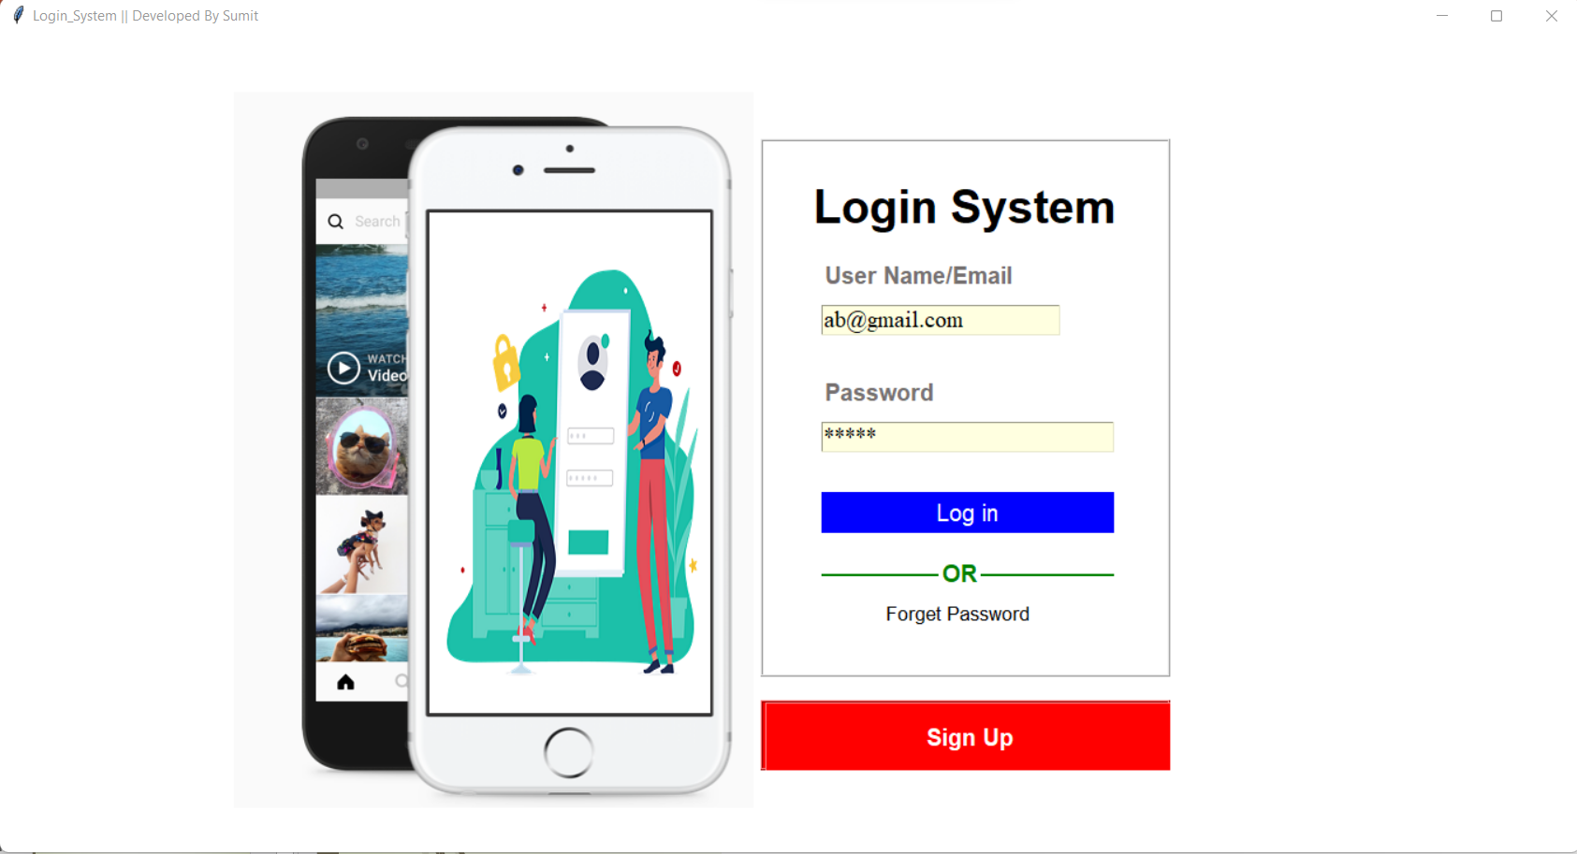
First Research area Frontend
_____________________
9
Supporting content
Firstly the LOGIN PAGE will appear which will ask for your “Username/Email” and “Password” and it will match the entered username and password from the database and if its get a match from the database it will take you the perform Inventory management system.

Slide 10
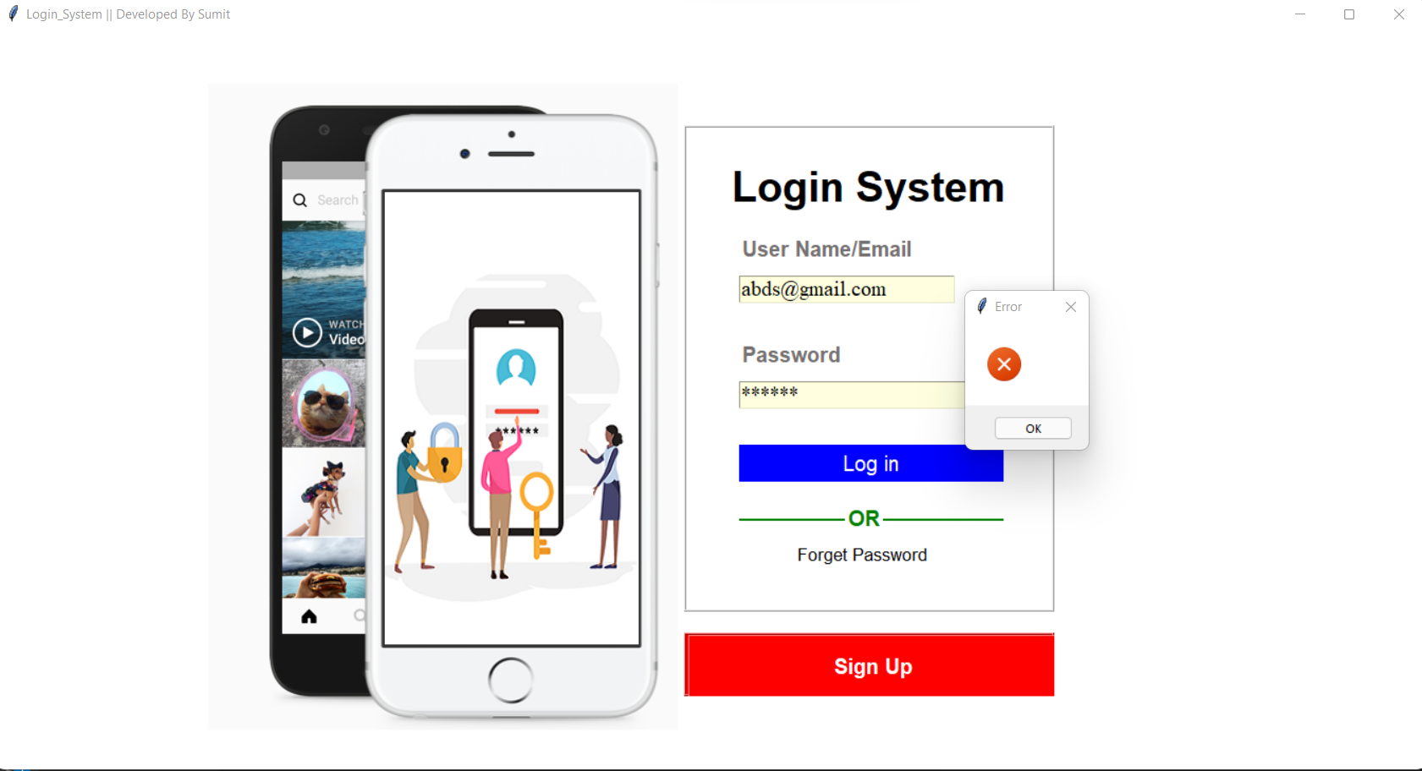
If we enter wrong username and password then it will display “Invalid Username/Email and password”.
10

Slide 11

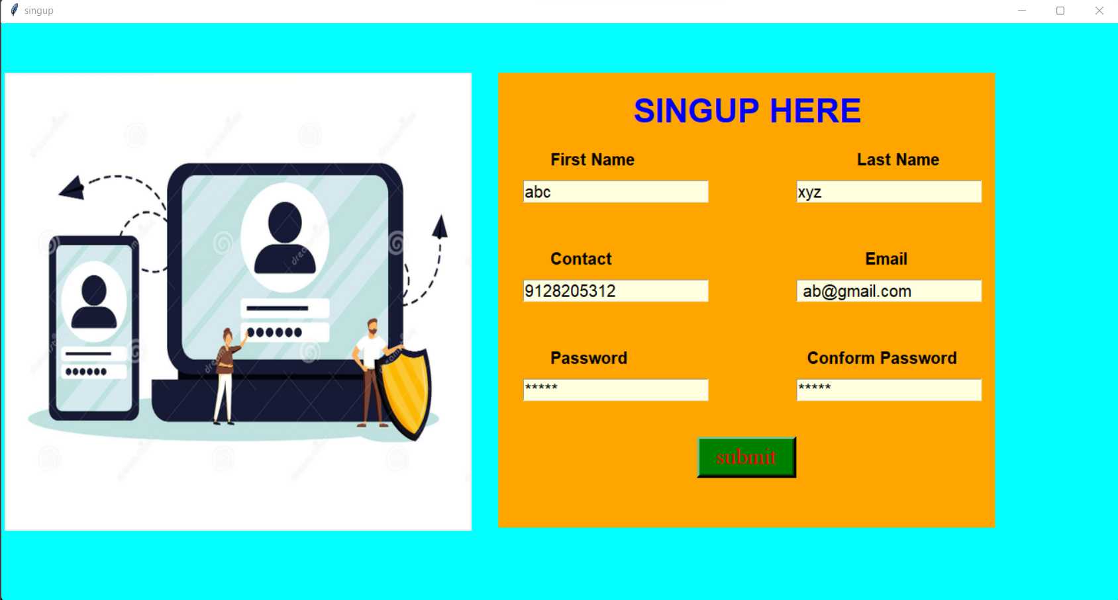
_____________________
If you are new user then Signup firstly.
11

Slide 12
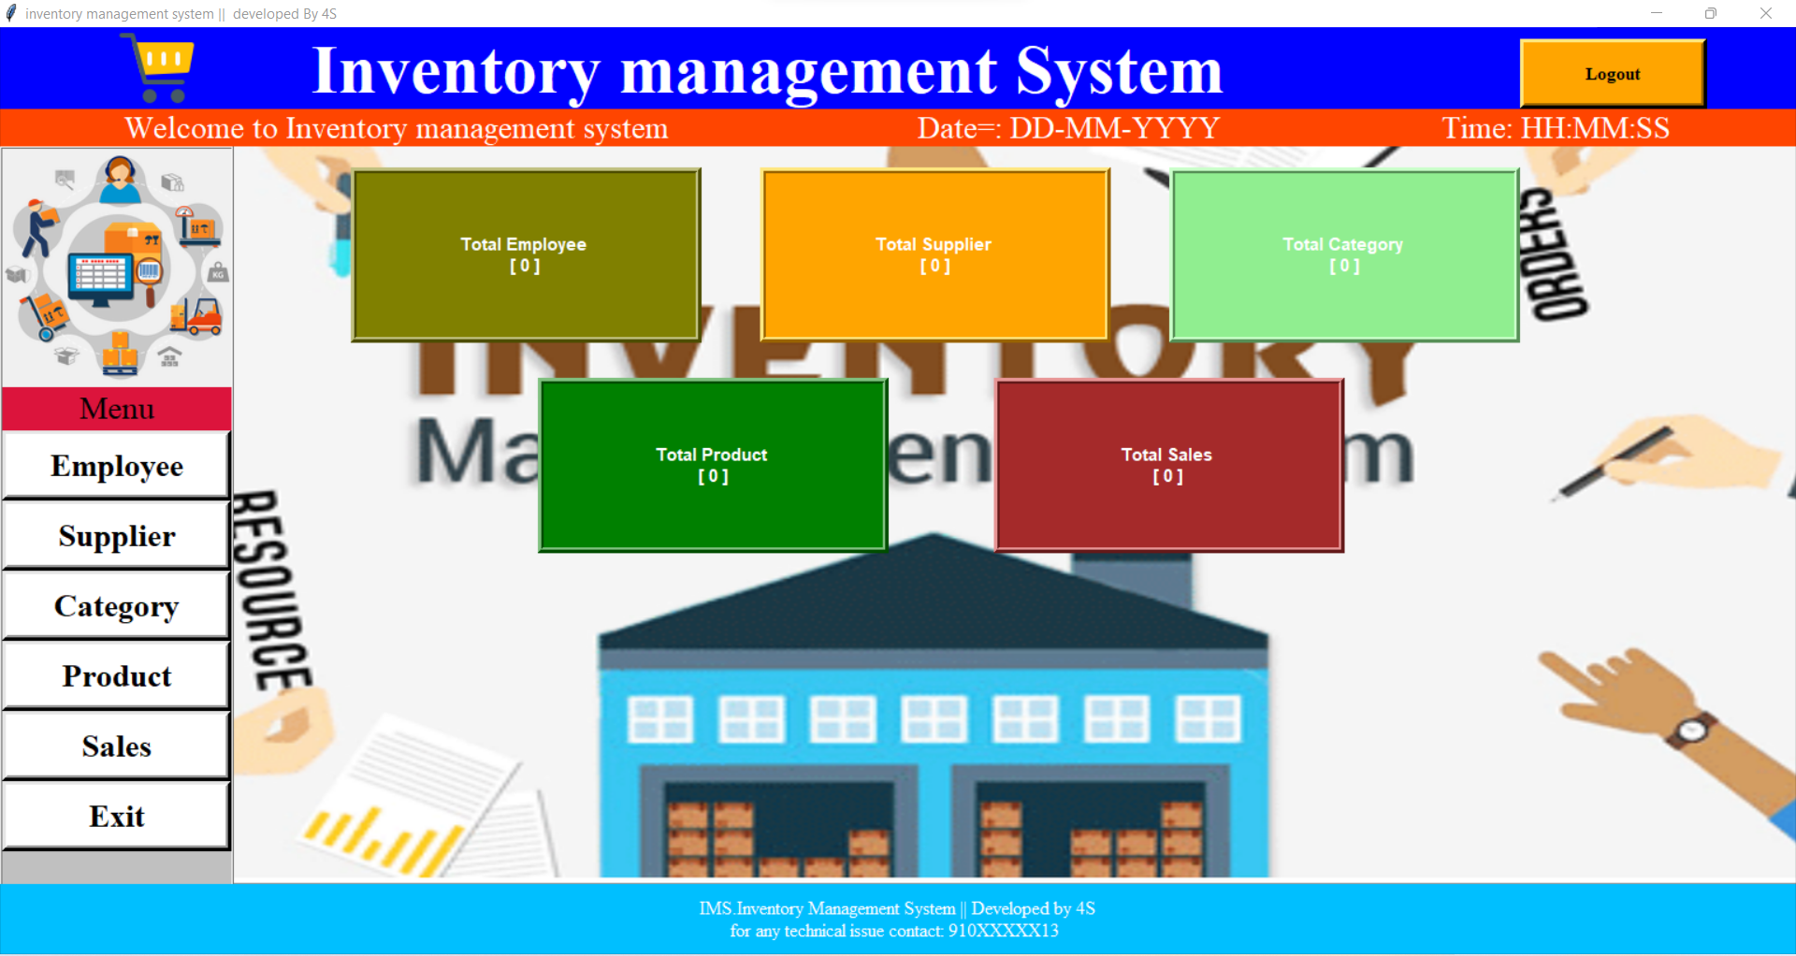
______________________
Supporting Content(Main Screen)
12

Slide 13
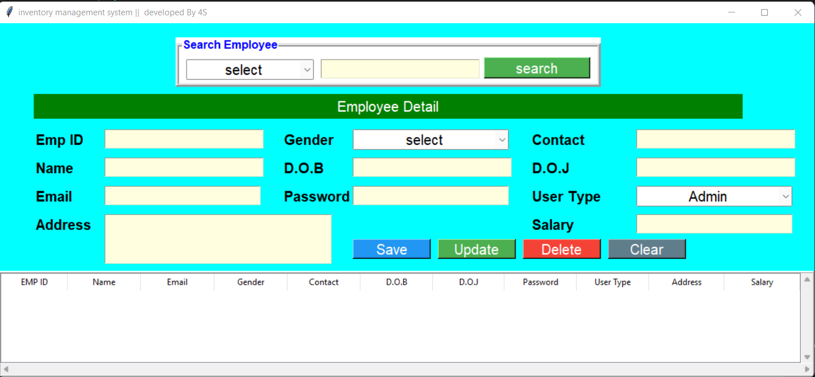
__________________
Select the Employee Detail
13

Slide 14
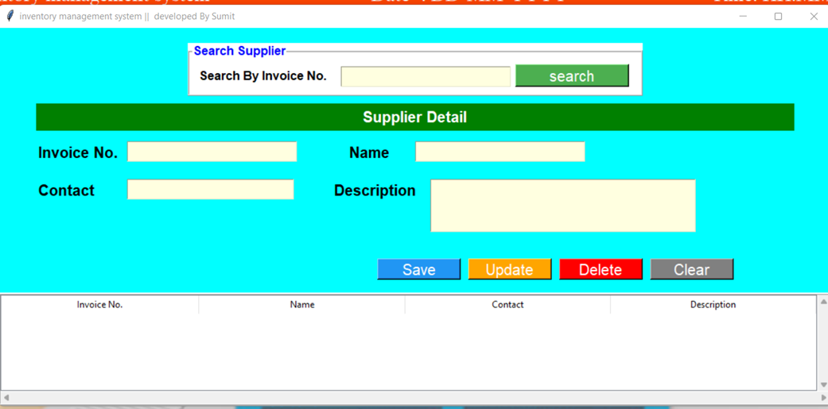
Select supplier Detail
_______________________
14

Slide 15
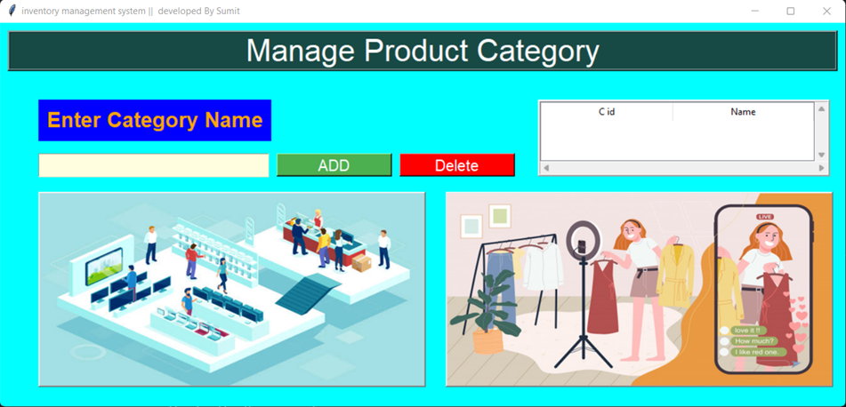
Select Category Detail
_______________________
15

Slide 16
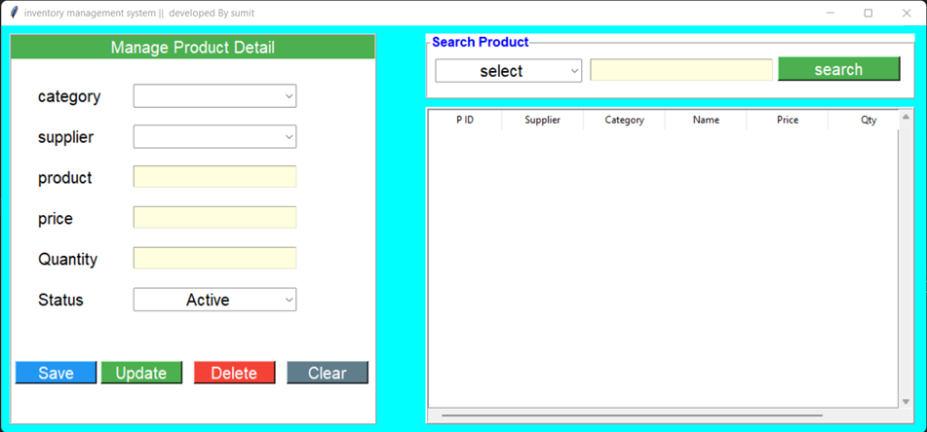
Select Product Detail
_____________________
16

Slide 17
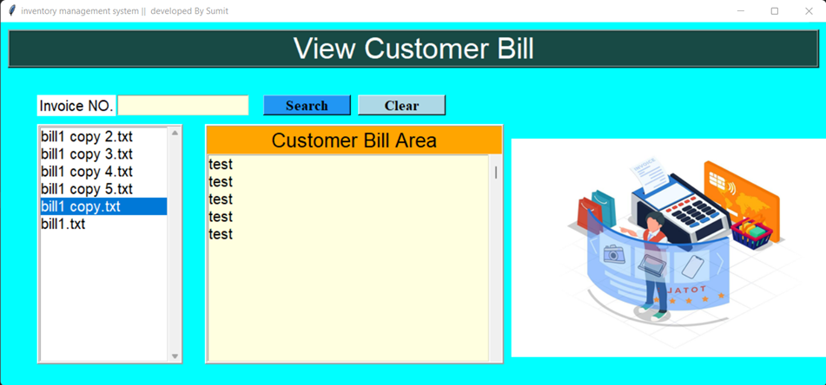
Select Sales Detail
____________________
17

Slide 18
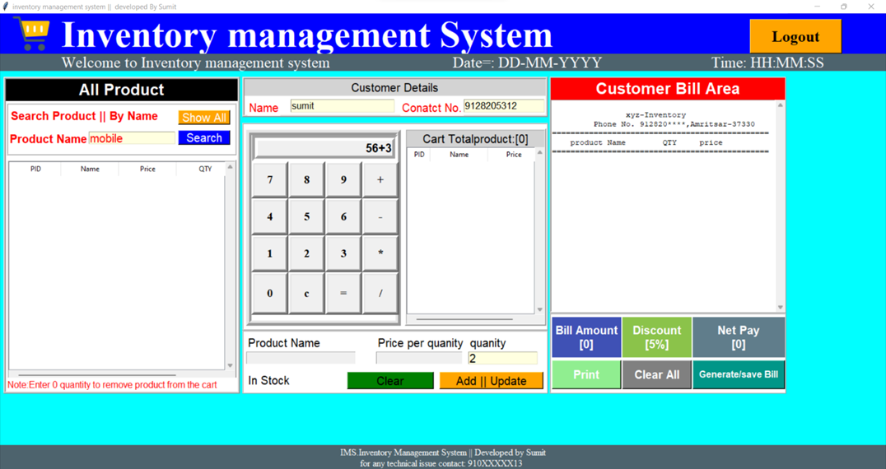
Billing Detail
__________________
18

Slide 19

19

